Slide 1
Word Sense Disambiguation
in Medical Context
Project 31 — Natural Language Processing & Text Mining
Lesk variants, a phonetic–semantic hybrid and a neural comparison on MSH-WSD
Giorgio Alleva · Francesca Lonardo
University of Oulu
github.com/pygiopoli/nlp_project_26
Notes:
Speaker: Giorgio (about 20 seconds). Good morning. We are Giorgio Alleva and Francesca Lonardo, and our project is about word sense disambiguation in the medical domain. I will introduce the problem and the first tasks, Francesca will present the experiments on the medical dataset, and at the end I will show our web interface.

Slide 2
One word, several medical meanings
The problem
cold
CAD
a low temperature, or the common cold
coronary artery disease, or computer-aided diagnosis
Word Sense Disambiguation chooses the meaning used in the context. In medicine its errors propagate to information extraction, indexing and search of the literature.
Giorgio
Sources: Schuemie et al., 2005 · Savova et al., 2008
2
Notes:
Speaker: Giorgio (about 1 minute). Word sense disambiguation is the task of choosing which meaning of an ambiguous word is used in a context. In the medical domain this is especially important. A regular word like "cold" can mean a low temperature or the disease. Acronyms are even more ambiguous: CAD can be coronary artery disease or computer-aided diagnosis. WSD is usually one step of a larger system, so its errors propagate: if a system extracts information from articles, indexes them, or answers a search, choosing the wrong meaning gives wrong results. The review by Schuemie and colleagues makes the same point: without WSD, the automatic analysis of large biomedical corpora remains error-prone. And the problem changes with the text: Savova and colleagues found that only 20% of the most relevant ambiguous terms are shared between the scientific literature and clinical notes, where terms have even more senses. Our project studies how classical knowledge-based algorithms perform on this problem.

Slide 3
The project, task by task
The project
Task | What we did | Who
1 | NLTK Lesk on an example sentence (drug) | Giorgio
2 | Lesk on 10 acronyms and 10 terms of MSH-WSD | Francesca
3 | pywsd algorithms on three example sentences | Francesca
4 | pywsd algorithms on MSH-WSD | Francesca
5 | Phonetic similarity: Soundex and edit distance, in seven languages | Giorgio
6 | Wu–Palmer combined with phonetic similarity | Francesca
7 | Web interface (Django) | Giorgio
9 | Tasks 4 and 6 on the full dataset, with an automatic CUI → WordNet mapping | Francesca
10 | Phonetic matching inside our simplified Lesk | Francesca & Giorgio
11 | SapBERT on the UMLS senses, without WordNet | Francesca
Giorgio
3
Notes:
Speaker: Giorgio (about 30 seconds). The project is organised in numbered tasks, and every slide is labelled with the task it presents. I worked on the first example with Lesk, on the phonetic similarity, also across seven languages, and on the web interface. Francesca worked on the experiments on the medical dataset, on the comparison of the pywsd algorithms and on the phonetic–semantic method, and on the last three tasks: the full dataset with an automatic mapping, a phonetic version of Lesk and a neural model.

Slide 4
A stopword decides the answer
Task 1 — Lesk on an example sentence
“I have been prescribed two important drugs today during my visit to clinic”
Version | Chosen sense | Result
Standard Lesk | administer a drug to | wrong
Nouns only | medicine or narcotic | right
POS tagger | medicine or narcotic | right
Extended Lesk | medicine or narcotic | right
Why it fails
“administer a drug to” wins only because of the word to; the correct sense shares no word with the sentence.
Giorgio
4
Notes:
Speaker: Giorgio (about 1 minute). In Task 1 we ran the standard Lesk of NLTK on this sentence, with target word "drug". WordNet has three senses: one noun, the medicine, and two verbs. Standard Lesk chooses the verb "administer a drug to". The reason is that the correct definition shares no word with the sentence, while this one shares the stopword "to", and the other verb shares "drugs". It is a tie, and the first sense wins. If we keep only the noun senses, or we use a POS tagger, Lesk is right, but only because there is a single noun sense. Our extended Lesk is also right, but with very weak evidence. So, on a short sentence, Lesk is fast but close to a guess.

Slide 5
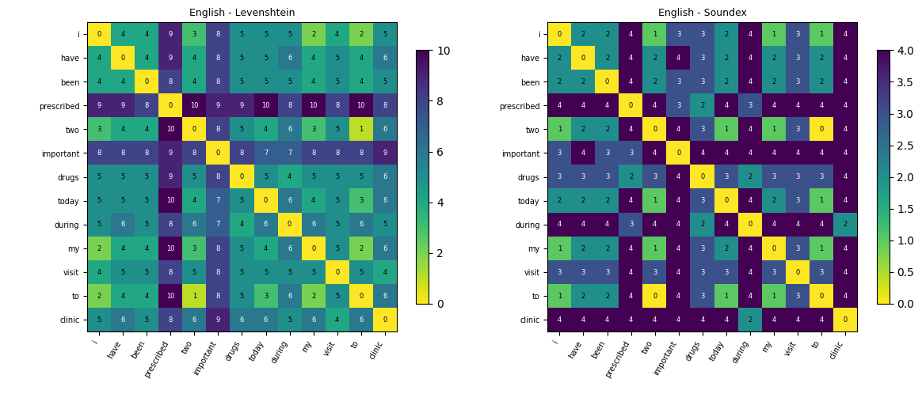
Soundex groups words by sound
Task 5 — Phonetic similarity
two = to = T000
Soundex keeps the first letter and turns consonants into digits. Similarity = 1 − d / 4, with d the Levenshtein distance between codes.
Written in our own utils.py: the Fuzzy library no longer builds on modern Python.
Giorgio
5
Notes:
Speaker: Giorgio (about 1 minute 15). Task 5 asked us to measure how similar two words sound. We used Soundex: it keeps the first letter and replaces the following consonants with digits for groups of similar sounds, giving a four-character code. The phonetic distance is the Levenshtein distance between the two codes, and the similarity is one minus that distance divided by four. The task suggested the Fuzzy library, but it is no longer maintained and does not build on modern Python, so we implemented Soundex and Levenshtein ourselves in utils.py. Here you see the two matrices for the sentence of Task 1. On the left, the plain Levenshtein distance mostly reflects the length of the words. On the right, the Soundex distance groups words that sound alike: "two" and "to" have the same code, so their distance is zero. This is correct phonetically, but it already shows a limit: two words can sound the same and mean different things. We then translated the sentence into six other languages, to see how Soundex behaves outside English.

Slide 6
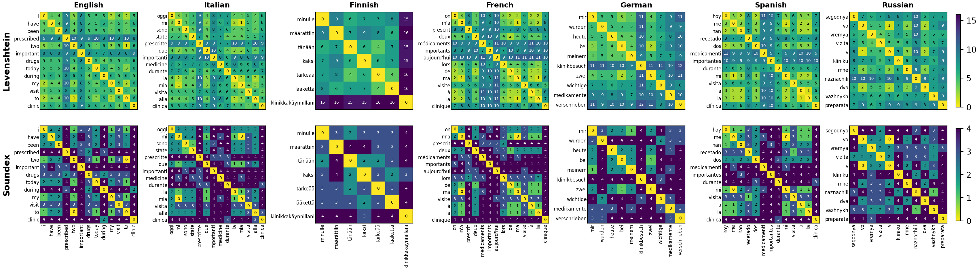
Soundex follows English spelling, not sound
Task 5 — The same sentence in seven languages
Long words, long distances
Soundex saturates
Built for English spelling
Finnish needs 7 words, English 13. Levenshtein reaches 16 against 10: it mostly measures word length.
68–80% of pairs sit at 3–4 in every language. Zeros only for short words: to/two, mi/mia, me/mi.
Letters like ä, é, í are dropped; Russian must be transliterated; clinic (C452) ≠ Klinik (K452).
Giorgio
6
Notes:
Speaker: Giorgio (about 1 minute). We translated the sentence of Task 1 into Italian, Finnish, French, German, Spanish and Russian, and computed the same two matrices: Levenshtein on top, Soundex below. Three things stand out. First, the plain edit distance depends on how long the words are. Finnish says the whole sentence in 7 words instead of 13, with compounds like "klinikkakäynnilläni", so distances go up to 16, while in English they stop at 10; German, with "Klinikbesuch", is in between. Second, Soundex compresses every word into four characters, so most pairs end up at distance 3 or 4 in all languages, between 68 and 80 percent. The only zeros are short function words with the same consonants: "to" and "two" in English, "mi" and "mia" in Italian, "me" and "mi" in Spanish; in Finnish and German there are none. Third, Soundex was designed for English spelling: letters like ä, é or í are simply dropped, Russian has to be transliterated before it can be coded, and the first letter is kept as it is written, so "clinic" (C452) and the German "Klinik" (K452) never match, even though the rest of the code is identical. So Soundex measures how a word is written in English, not how it sounds in each language. Grouping the languages by family makes this clearer.

Slide 7
Spelling and word length separate the families
Task 5 — Language families
Romance
Germanic
Uralic
Slavic
Italian · French · Spanish
English · German
Finnish
Russian (transliterated)
10–11
10 · 12
16
10
max Levenshtein
max Levenshtein
max Levenshtein
max Levenshtein
68–73%
69% · 75%
80%
69%
Soundex pairs at 3–4
Soundex pairs at 3–4
Soundex pairs at 3–4
Soundex pairs at 3–4
Short articles and prepositions (la, mi, de, me) give the few low distances; silent French letters still count.
English is the case Soundex was built for; German packs words into compounds (Klinikbesuch).
Agglutinative: 7 long words, not one Soundex zero, and ä is dropped (tänään → T500).
Coded only after transliteration, so the result depends on the scheme (zh, kh, ya).
Same Latin root, same code
M325: medicine (IT), médicaments, medicamentos, Medikamente · C452: clinica, clinique, clínica, like English clinic · K452: Klinik, kliniku · no shared root, no match: lääkettä L230, preparata P616, drugs D620
Giorgio
One sentence per language: indicative, not statistical
7
Notes:
Speaker: Giorgio (about 1 minute). Grouping the seven languages by family makes the differences clearer. The Romance languages, Italian, French and Spanish, behave like English: words of about five letters, edit distances up to 10 or 11, and around 70% of the Soundex pairs at distance 3 or 4; the few low distances come from short articles and prepositions like "la", "mi" and "de". French adds silent letters, which Soundex codes as if they were pronounced. Among the Germanic languages, English is the case Soundex was designed for, while German has fewer and longer words because of compounds like "Klinikbesuch", so both distances grow. Finnish, a Uralic and agglutinative language, is the extreme case: seven long words, edit distances up to 16, 80% of the Soundex pairs saturated and not a single zero; letters like ä are simply dropped. Russian, a Slavic language, can only be coded after transliteration, so its codes depend on the transliteration scheme. The most interesting effect is across languages: words with the same Latin root get the same code, so "medicine", "médicaments", "medicamentos" and even the German "Medikamente" are all M325, and "clinica", "clinique" and "clínica" share C452 with the English "clinic". Words without a shared root, like the Finnish "lääkettä" or the Russian "preparata", never match. With one sentence per language these are indications, not statistics. Now Francesca will present the experiments on the medical dataset.

Slide 8

The answers and the algorithms use different senses
Tasks 2 & 9 — The MSH-WSD dataset
Correct answer in the dataset
Answer of Lesk
C0015422
eyelash.n.01
our mapping
a UMLS code (CUI): “Eyelash”
a WordNet sense (synset)
203 words: 108 acronyms and 92 terms (3 mixed words excluded)
Manual mapping for the 39 words of our two selections
Automatic mapping for all 200 words: 89% of its links are correct
Francesca
Sources: Weeber et al., 2001 · Jimeno-Yepes et al., 2011
8
Notes:
Speaker: Francesca (about 1 minute 15). As required by the project, we used the MSH-WSD dataset, which contains 203 ambiguous medical words. It was built by Jimeno-Yepes, McInnes and Aronson in 2011 from the manual MeSH indexing of MEDLINE, and it extends the earlier NLM WSD collection of Weeber and colleagues, which had only 50 ambiguous strings. For each word, the dataset gives its possible meanings as UMLS codes, called CUIs, and a list of abstracts, each one labelled with the correct meaning in that context. The dataset does not say which words are acronyms and which are terms, so we divided them with simple rules, based on capital letters and digits, and we corrected the results by hand. We obtained 108 acronyms and 92 terms. Here we found the main problem of the project: the correct answers are UMLS codes, but Lesk and the other algorithms answer with WordNet senses. So we had to build a mapping between the two. For each word, we retrieved the names of its CUIs from UMLS and looked up its senses in WordNet, and we matched them by hand for the 39 words of our two selections. For the full dataset, in Task 9, we mapped the senses automatically, by matching names and counting the words in common between the UMLS and WordNet definitions: on our 39 manually mapped words it reaches a precision of 0.89 and a recall of 0.77.

Slide 9
Two different reasons to fail
Task 2 — Lesk on MSH-WSD
Selection | Group | Accuracy | Coverage | Acc. covered
1: random, 10 + 10 words | Acronyms | 0.25 | 0.30 | 0.85
 | Terms | 0.43 | 0.57 | 0.83
2: at least 2 WordNet senses | Acronyms | 0.19 | 0.28 | 0.61
 | Terms | 0.40 | 0.95 | 0.45
Acronyms: a WordNet problem
Terms: an algorithm problem
Coverage stays below 0.30 even in selection 2: most medical meanings are missing. Even UMLS covers only 5.7% of clinical abbreviation senses.
Coverage 0.95 in selection 2, but Lesk is right on only 45% of covered abstracts.
Coverage: abstracts whose correct meaning exists in WordNet, the best Lesk could do. Acc. covered: accuracy on those abstracts only, high in selection 1 because many words have a single sense.
Francesca
Source: Moon et al., 2014
9
Notes:
Speaker: Francesca (about 1 minute). In Task 2 we ran the standard Lesk of NLTK on a random selection of 10 acronyms and 10 terms. To evaluate it we used two measures: the accuracy, and the coverage, that is the share of abstracts whose correct meaning exists in WordNet, which is the best Lesk could ever do. Lesk reaches 25% accuracy on acronyms, with a coverage of only 30%, and 43% on terms, with a coverage of 57%. However, more than half of these words had zero or one WordNet sense, so Lesk had nothing to choose. We therefore drew a second selection among words with at least two WordNet senses. This is a necessary condition, not a sufficient one: a word can have several senses that are not medical. In fact, coverage rose to 95% for terms, but stayed at 28% for acronyms. So we have two different reasons to fail. For acronyms the problem is WordNet: most medical meanings are missing. And this is not only a WordNet problem: Moon and colleagues found that even UMLS covers only 5.7% of the long forms of clinical abbreviations. For terms the problem is the algorithm: even with 95% coverage, Lesk is right on only 45% of the covered abstracts.

Slide 10
Errors are systematic, so they can be fixed
Task 2 — Errors and improvements
The same wrong sense every time
Accuracy on covered abstracts
Acronyms
Terms
Word | Lesk’s answer | Abstracts
Milk | a river in Montana | 174 / 198
RA | right ascension | 288 / 297
US | uracil | 154 / 198
Cement | building material | 160 / 185
Standard Lesk
0.61
0.45
+ stopword removal
0.88
0.48
+ noun senses only
0.88
0.53
Our Lesk + examples, synonyms
0.92
0.56
The match is made almost only of stopwords (the, in, and).
0.90
MFS: first WordNet sense
0.35
Francesca
10
Notes:
Speaker: Francesca (about 1 minute). Looking at the errors, we found that Lesk often chooses a sense only because its definition shares stopwords like "the" and "in" with the abstract: for example, Milk becomes "a river in Montana" in 174 abstracts out of 198. So we tried simple improvements: removing stopwords, giving Lesk only the noun senses, and then writing our own Lesk, which also uses the WordNet examples and synonyms of each sense. On the covered abstracts, accuracy rises from 45% to 56% on terms, and from 61% to 92% on acronyms. We also compared Lesk with the most frequent sense baseline, which always chooses the first WordNet sense. On terms Lesk is clearly better, 56% against 35%, but on acronyms they are almost equal: there, most of the gain comes from falling back on the first sense.

Slide 11
The Lesk family does best on the examples
Task 3 — pywsd on three sentences
“I have been prescribed two important drugs today during my visit to clinic”
Algorithm | drug | bank | ventricle
Original Lesk | wrong | right | right
Simple Lesk | right | right | right
Adapted Lesk | right | right | right
Cosine Lesk | right | wrong | right
Path | right | wrong | wrong
Wu–Palmer | right | wrong | wrong
Leacock–Chodorow | right | wrong | wrong
Resnik | wrong | wrong | wrong
Jiang–Conrath | right | wrong | wrong
Lin | right | wrong | wrong
Max lemma count | right | wrong | wrong
the sentence of Task 1, to compare with NLTK
“I went to the bank to deposit my money”
the pywsd example, to check the library
“The left ventricle of the heart pumps blood to the body”
a medical sentence: heart or brain ventricle
Problems found: Resnik returns the lowest score; Jiang–Conrath gives every sense an infinite score.
Francesca
Similarity measures in biomedical WSD: McInnes & Pedersen, 2013
11
Notes:
Speaker: Francesca (about 1 minute). In Task 3 we studied the algorithms of the pywsd library: four versions of Lesk, six similarity measures based on the WordNet hierarchy, and the max lemma count baseline. We tested them on three sentences, each with a different purpose: the sentence of Task 1, to compare with NLTK; the bank example of the library, to check that it works; and a medical sentence with "ventricle", which can be the heart or the brain. The Lesk family does best: all its versions find the heart ventricle, thanks to words like heart, blood and pump. The similarity methods instead fail on bank and ventricle: they only use the "is-a" hierarchy of WordNet, so they cannot see that the ventricle is part of the heart. We also printed the full ranking of the senses, not only the answer, and this helped us find two problems in the library: Resnik returns the sense with the lowest score instead of the highest, and Jiang–Conrath gives an infinite score to every sense, so it always returns the first one.

Slide 12
Changing the algorithm is not enough
Tasks 4 & 9 — pywsd on the full dataset
Accuracy, 200 words
Acronyms
Terms
All methods give similar results: the best ones are within 2 points of each other, so the limit is WordNet, not the algorithm.
Path
0.145
0.244
Adapted Lesk
0.143
The accuracy is low because the automatic mapping finds a WordNet sense for only 16% of the acronym abstracts and 38% of the term abstracts.
0.250
Lin
0.143
0.240
Wu–Palmer
0.141
0.222
After fixing its ranking, Resnik goes from the worst method to one of the best.
NLTK Lesk
0.124
0.229
Max lemma count
0.135
0.196
Resnik (pywsd)
0.107
0.161
Resnik (fixed)
0.143
0.237
Francesca
Knowledge-based WSD on UMLS: Agirre et al., 2010 · McInnes & Pedersen, 2013
12
Notes:
Speaker: Francesca (about 1 minute). In Task 4, extended to the whole dataset in Task 9, we ran all these methods on all 200 words, using the automatic mapping. The accuracy is lower than on our selected words, because the automatic mapping covers fewer senses: only about 16% of the acronym abstracts and 38% of the term abstracts. But the main result is clear: the methods are very close to each other, the best ones differ by less than two points. Changing the algorithm is not enough, because the real limit is WordNet. In the literature the same knowledge-based ideas are applied to UMLS instead: McInnes and Pedersen evaluated these similarity measures on biomedical text, and Agirre and colleagues used a graph-based method with personalized PageRank. The only big change comes from the bug we found: after we fixed the order of the ranking, Resnik went from the worst method to one of the best.

Slide 13
Adding phonetics to Wu–Palmer changes little
Tasks 6 & 9 — Phonetic–semantic hybrid
sim(s, s′) = α · WuP(s, s′) + (1 − α) · Phon(s, s′)
WuP: how close two senses are in the WordNet hierarchy.
Accuracy, 39 words
Acronyms
Terms
Wu–Palmer (pywsd)
0.250
Phon: the best Soundex similarity between the names of the two senses. It must compare senses, not words, or every sense of the target would get the same score.
0.345
α = 1
0.248
0.345
α = 0.8
0.249
0.332
α = 0.5
0.265
0.342
Full dataset, α = 1 → 0.5: acronyms 0.130 → 0.134, terms 0.221 → 0.231.
Francesca
Similarity measures in biomedical WSD: McInnes & Pedersen, 2013
13
Notes:
Speaker: Francesca (about 1 minute 15). Task 6 was the original part of the project. We extended the Wu–Palmer method with the phonetic similarity that Giorgio presented. The new similarity between two senses is a combination: alpha times Wu–Palmer, plus one minus alpha times the phonetic similarity. One important choice: the phonetic part must compare senses, not words. If we compared only the target word with the context, every sense of the target would get the same phonetic score, and nothing would change. So we compare the names of the senses, using their Soundex codes. With alpha equal to 0.5 the results change very little: one and a half points on acronyms, and almost nothing on terms. On the full dataset, in Task 9, the effect is similar, about one point on terms. It helps on some words and hurts on others, because Soundex is too coarse: it gives the same code to words like "drug" and "dirge", which sound similar but have nothing in common.

Slide 14
Phonetics inside Lesk
Task 10 — Phonetic Lesk
Lesk only counts words written in exactly the same way, so spelling variants never match. We kept our Lesk of Task 2 and changed only the rule that decides when a context word matches a word of the sense definition.
When do two words count as equal? We tried three rules:
Exact
Soundex
Edit distance (Levenshtein)
identical words, as in standard Lesk
same Soundex code: tumour and tumor, but also cell and cello
at most one letter to add, remove or change: oedema and edema
Accuracy, 39 words
Acronyms
Terms
Soundex makes Lesk worse: it matches unrelated words, which give points to wrong senses.
Exact
0.255
0.429
Soundex
0.242
Edit distance helps a little on terms: it changes the answer in only 38 of 810 abstracts.
0.403
Levenshtein
0.252
0.439
Francesca
14
Notes:
Speaker: Francesca (about 45 seconds). In Task 10 we put phonetics directly inside Lesk. Lesk counts a word as shared only if it is written in exactly the same way, so spelling variants never match. We kept our Lesk of Task 2 and changed only this rule: two words count as equal if they have the same Soundex code, or if they differ by at most one letter. Soundex makes Lesk worse, because it also matches unrelated words like "cell" and "cello", and these matches give points to wrong senses. The one-letter rule helps a little on terms, because it catches spelling variants like "oedema" and "edema", but it changes the answer in only 38 abstracts out of 810.

Slide 15
A method that does not need WordNet
Task 11 — SapBERT
Since WordNet was the main limit, we compared the context directly with the UMLS meanings, using SapBERT, a biomedical BERT model trained on UMLS synonyms.
1
Each meaning is described by its UMLS names and definition, and turned into a vector.
Accuracy, 39 words
Acronyms
Terms
Our Lesk
0.26
0.43
2
The 10 words before and after the target are turned into a vector.
0.26
Best pywsd
0.37
3
We choose the meaning whose vector is closest to the context.
SapBERT
0.84
0.72
On all 200 words: 0.88 on acronyms and 0.71 on terms, close to the UMLS methods in the literature (about 0.81 to 0.84).
Francesca
Sources: Jimeno-Yepes et al., 2011 · Jin et al., 2019 · Adams et al., 2020 · Wen et al., 2020
15
Notes:
Speaker: Francesca (about 1 minute 15). In Task 11, since WordNet was the main limit, we tried a method that does not need it at all. We used SapBERT, a biomedical language model trained on UMLS, so that synonyms of the same concept get close vectors. It works in three steps: we describe each meaning with its UMLS names and its definition and turn this text into a vector; we turn the ten words before and after the target into a vector too; and we choose the meaning whose vector is closest. We did not train it on our dataset. The difference is huge: on our 39 words SapBERT reaches 84% on acronyms and 72% on terms, while our Lesk and the best pywsd methods stay around 26% on acronyms and 40% on terms. On all 200 words it reaches 88% and 71%, close to the UMLS-based methods in the literature. And now acronyms become the easiest case, because their meanings are very different from each other. Neural models are also the current direction in the literature on medical abbreviations: DECBAE, by Jin and colleagues, reaches 0.96 accuracy on PubMed abbreviations; MeDAL, by Wen and colleagues, shows that pre-training on abbreviation disambiguation helps later medical tasks; and Adams and colleagues expand clinical acronyms zero-shot. (If asked: a wider context does not help, and names together with the definition work better than either alone.) I will now leave the floor to Giorgio, who will show you our interface.

Slide 16
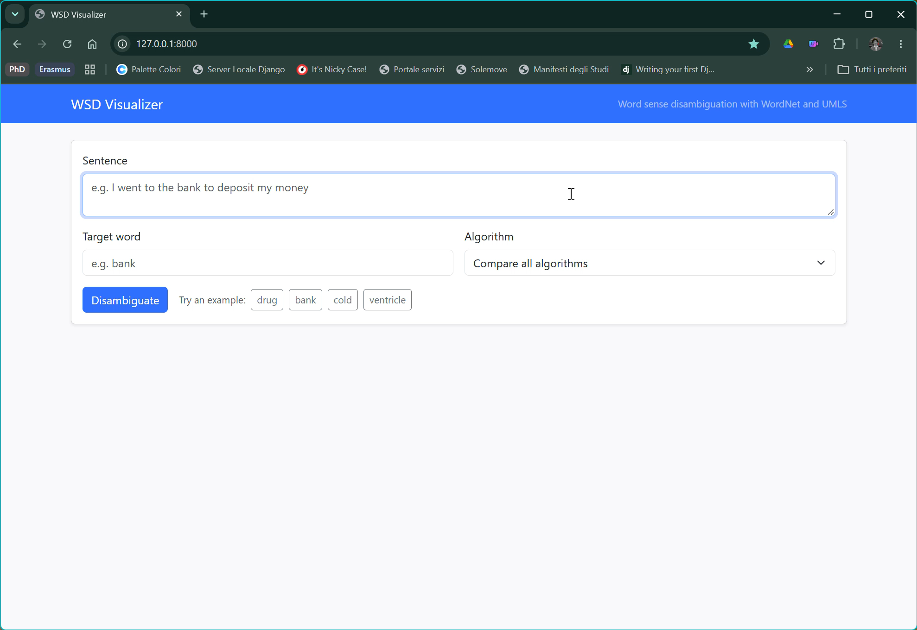
Try the algorithms on your own sentence
Task 7 — Web interface
Input
a biomedical sentence and a target word
Methods
NLTK Lesk variants, pywsd, our hybrid, SapBERT
Output
the chosen sense, its definition and the full ranking
Stack
Django back end in Python, Bootstrap 5
Giorgio
16
Notes:
Speaker: Giorgio (about 1 minute 30, including the demo). To make our methods easy to try, we built a web application with Django. The back end is written in Python and calls the same disambiguation functions we used in the experiments; the front end uses Bootstrap 5. The user writes a biomedical sentence, chooses the target word and the algorithm: the NLTK Lesk variants, the pywsd methods, our phonetic–semantic hybrid, or SapBERT. The interface shows the chosen sense with its definition, and the full ranking of the candidate senses, so you can see why a method made its choice. [Live demo: for example "The left ventricle of the heart pumps blood to the body", target "ventricle": compare a Lesk method with SapBERT.] It runs locally with python manage.py runserver; it is a demo, so it is still in Django's debug mode.

Slide 17
Three things we learned
Conclusions
1
2
3
The knowledge source matters more than the algorithm
Simple fixes and error analysis matter
Sound is not meaning
Phonetic similarity gives at most +0.015; only edit distance helps a little.
WordNet methods differ by less than 0.02; UMLS with SapBERT reaches 0.88 and 0.71.
Stopwords, richer signatures and reading the library code (the Resnik bug).
Giorgio
Sources: Stevenson et al., 2008 · Moon et al., 2014
17
Notes:
Speaker: Giorgio (about 1 minute). To conclude, we learned three things. First, the knowledge source matters more than the algorithm: all the WordNet-based methods stay in the same range, because WordNet does not contain most medical meanings, while a model that uses UMLS directly reaches 88% on acronyms and 71% on terms. This agrees with the literature: Stevenson and colleagues obtained their best results by adding MeSH terms, that is domain knowledge, and Moon and colleagues showed how incomplete even medical sense inventories are. Second, simple fixes and careful error analysis matter: removing stopwords and enriching the signatures gave the largest gains, and reading the code of the library revealed a bug in Resnik. Third, sound is not meaning: phonetic similarity gives at most one and a half points, and only a careful edit distance helps a little, by catching spelling variants.

Slide 18
The literature behind our choices
Task 8 — Related literature
Reviews and data sets
Classical methods
Abbreviations and neural models
Schuemie, Kors & Mons (2005). Word sense disambiguation in the biomedical domain: an overview. J Comput Biol 12(5):554–565.
Stevenson et al. (2008). Disambiguation of biomedical text using diverse sources of information. BMC Bioinformatics 9(Suppl 11):S7.
Moon et al. (2014). A sense inventory for clinical abbreviations and acronyms created using clinical notes and medical dictionary resources. JAMIA 21(2):299–307.
Weeber, Mork & Aronson (2001). Developing a test collection for biomedical word sense disambiguation. Proc AMIA Symp.
Savova et al. (2008). Word sense disambiguation across two domains: biomedical literature and clinical notes. J Biomed Inform.
Jin, Liu & Lu (2019). Deep contextualized biomedical abbreviation expansion. BioNLP 2019.
Jimeno-Yepes, McInnes & Aronson (2011). Exploiting MeSH indexing in MEDLINE to generate a data set for word sense disambiguation. BMC Bioinformatics 12:223.
Agirre, Soroa & Stevenson (2010). Graph-based word sense disambiguation of biomedical documents. Bioinformatics 26(22):2889–2896.
Adams et al. (2020). Zero-shot clinical acronym expansion via latent meaning cells. ML4H @ NeurIPS, PMLR 136.
McInnes & Pedersen (2013). Evaluating measures of semantic similarity and relatedness to disambiguate terms in biomedical text. J Biomed Inform 46(6):1116–1124.
Wen, Lu & Reddy (2020). MeDAL: medical abbreviation disambiguation dataset for NLU pretraining. ClinicalNLP @ EMNLP.
Giorgio
18
Notes:
Speaker: Giorgio (about 20 seconds, or leave it on screen during questions). These are the papers we relied on: the reviews and the two biomedical test collections, NLM WSD and MSH-WSD; the classical supervised and knowledge-based methods, including the similarity measures and the graph-based approach on UMLS; and the recent work on clinical abbreviations and neural models. The titles are links to the papers.

Slide 19
Thank you.
Word Sense Disambiguation in Medical Context
Questions?
Giorgio Alleva · Francesca Lonardo
University of Oulu
github.com/pygiopoli/nlp_project_26
Notes:
Speaker: Giorgio (about 10 seconds). Thank you for your attention. We are happy to answer your questions.

